Slide 1
Data Mining
Ch 8/9: Classification – 3
Neural Networks
Wan D. Bae, Ph.D.
baewd@hanyang.ac.kr

Slide 2
Overview
Classification: basic concepts
Classification methods:
  Decision tree induction
  Bayesian classification methods
  Neural networks
  Rule-based classification
Classification accuracy

Slide 3
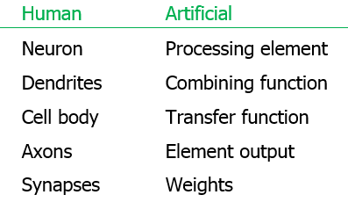
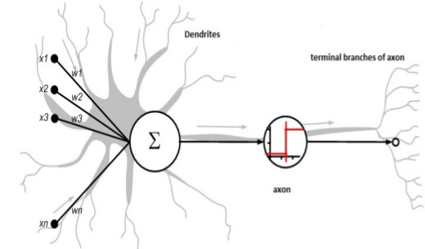
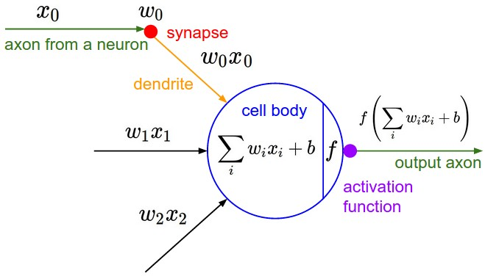
Neural Networks
Analogy to biological systems
  Neural networks attempt to
  mimic the structures and processes
  of biological neural systems

Slide 4
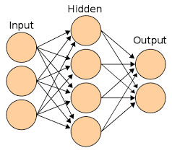
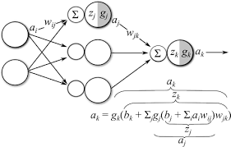
Neural Networks
A neural network is a set of connected input/output, each connection has a weight associated with it
  During the learning phase, the network learns by adjusting the weights to predict the correct class label of the input tuples
  Massive parallelism allowing for computational efficiency
Backpropagation: most popular neural network algorithm

Slide 5
A Multilayer Feed Forward Neural Network
Input layer: attribute values of training tuples are fed simultaneously into this layer
Hidden layer: output of the input layer are weighted and fed simultaneously to a (set of ) hidden layer(s) (usually one)
Output layer: the weighted outputs of the last hidden layer are input to the units of output layer which results in the classification of the given tuples
Feed Forward: none of the weights cycles back to an input unit or to an output unit of a previous layer
  Each output unit takes as input a linear sum of the weighted output of the previous layer. It then applies a nonlinear function (e.g., nonlinear regression) to the weighted input

Slide 6
A Multilayer Network: Example
Input layer
Hidden layer
Output layer
x₁
w_{1j}
x₂
w_{2j}
w_{ij}
w_{jk}
x_{i}
o_{j}
w_{nj}
o_{k}
x_{n}
A two-layer feed-forward fully connected neural network

Slide 7
Defining a Network Topology
Decide the network topology: specify
  # of units in the input layer
  # of hidden layers (if > 1)
  # of units in each hidden layer
  # of units in the output layer
Normalize the input values for each attribute measured in the training tuples to [0.0—1.0]
One input unit per domain value, each initialized to 0
Output, if for classification and more than two classes, one output unit per class is used
Once a network has been trained and its accuracy is unacceptable, repeat the training process with a different network topology or a different set of initial weights

Slide 8
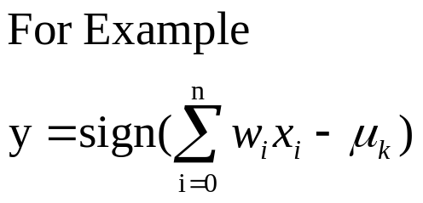
Neuron: A Hidden/Output Layer Unit
bias
μ_{k}
x₀
w₀
x₁
w₁
∑
f
output y
x_{n}
w_{n}
Input
vector x
weight
vector w
weighted
sum (linear)
Activation
function (nonlinear)
An n-dimensional input vector x is mapped into variable y by means of the scalar product and a nonlinear function mapping
The inputs to unit are outputs from the previous layer. They are multiplied by their corresponding weights to form a weighted sum, which is added to the bias associated with unit. Then a nonlinear activation function is applied to it.

Slide 9
Backpropagation Algorithm
Iteratively process a set of training tuples and compare the network's prediction with the actual known target value
For each training tuple, the weights are modified to minimize the mean squared error between the network's prediction and the actual target value
Modifications are made in the “backwards” direction: from the output layer, through each hidden layer down to the first hidden layer, hence “backpropagation”

Slide 10
Backpropagation Learning
Obtain a set of weights that makes almost all the tuples in the training data classified correctly
Steps
  Initialize weights to random numbers, associated with biases
  Feed the input tuples into the network one by one:
  For each unit,
    Compute the net input to the unit as a linear combination of all the inputs to the unit
    Compute the output value using the activation function
    Compute the error by comparing the known class label
    Update the weights and the bias by backpropagating
  Terminating condition (when error is very small, etc.)

Slide 11
Efficiency and Interpretability
Efficiency of backpropagation: Each epoch (one iteration through the training set) takes O(|D| * w), with |D| tuples and w weights, but # of epochs can be exponential to n, the number of inputs, in worst case
For easier comprehension: Rule extraction by network pruning
  Simplify the network structure by removing weighted links that have the least effect on the trained network
  Then perform link, unit, or activation value clustering
  The set of input and activation values are studied to derive rules describing the relationship between the input and hidden unit layers
Sensitivity analysis: assess the impact that a given input variable has on a network output
  The knowledge gained from this analysis can be represented in rules

Slide 12
Neural Network as a Classifier
Weakness
  Long training time
  Require a number of parameters typically best determined empirically, e.g., the network topology or “structure.”
  Poor interpretability: Difficult to interpret the symbolic meaning behind the learned weights and of “hidden units” in the network
Strength
  High tolerance to noisy data
  Ability to classify untrained patterns on which they have not been trained
  Well-suited for continuous-valued inputs and outputs
  Successful on an array of real-world data, e.g., hand-written letters
  Parallel in nature to speed up the computation

Slide 13
Network Pruning and Rule Extraction
Network pruning
  Fully connected network will be hard to articulate
  N input nodes, h hidden nodes and m output nodes lead to h(m+N) weights
  Pruning: Remove some of the links without affecting classification accuracy of the network
Extracting rules from a trained network
  1. Discretize activation values; replace individual activation value by the cluster average maintaining the network accuracy
  2. Enumerate the output from the discretized activation values to find rules between activation value and output
  3. Find the relationship between the input and activation value
  4. Combine the above two to have rules relating the output to input

Slide 14
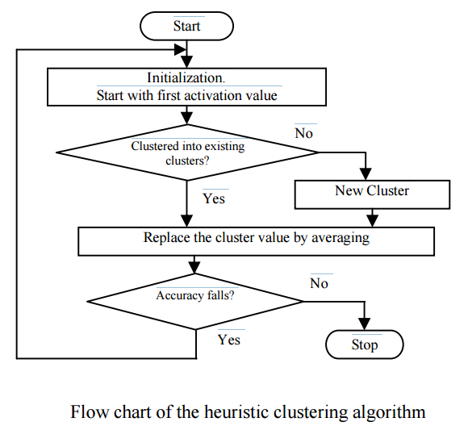
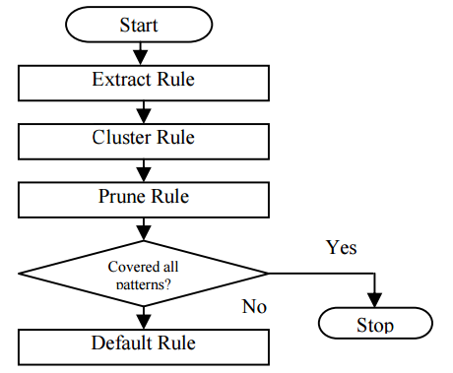
Examples of Rule Extraction

